Slide 1

PID CONTROLLERS
Assoc.Dr. Güleser K Demir
Assist. Dr. Hatice Doğan

Slide 2
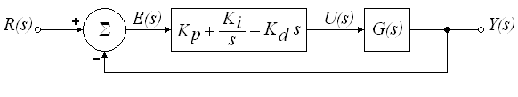

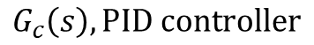
PID Controllers
$$G_{c}\left(s\right), \text{PID} \text{controller}$$
Plant that we want to control its output
PID controller takes the error e(t), as the input and computes its proportional, derivative and integral terms. Summation of these terms is outputted as the control signal u(t). This control signal is inputted to the plant, and a new output y(t) is obtained. This new output y(t) is measured by the sensor to find the new error signal e(t). The controllers takes this new to produce control signal. This process goes on and on.
Transfer function of PID controller is
In the time domain;
Eq.1
Eq.2
Proportional gain
Integral gain
Derivative gain
Eq.3
Proportional term
Integral term
Derivative term
1

Slide 3

$$G_{c}\left(s\right), \text{PID} \text{controller}$$
Plant that we want to control its output
Transfer function of PID controller is
If $K_{i}=0 \text{and} K_{d}=\text{0 }\text{then} G_{c}\left(s\right)=K_{p}$ Proportional (P) controller.
If $\text{only} K_{d}=\text{0 }\text{then} G_{c}\left(s\right)=K_{p}+\frac{K_{i}}{s}$ Proportional Integral (PI) controller.
If $\text{only} K_{i}=\text{0 }\text{then} G_{c}\left(s\right)=K_{p}+K_{d}s$ Proportional Derivative (PD) controller.
2

Slide 4
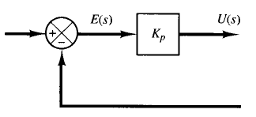
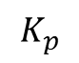
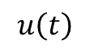
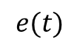
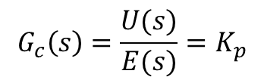
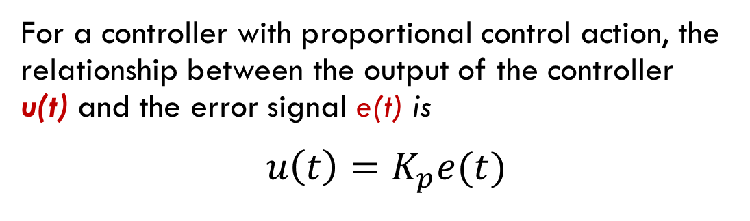
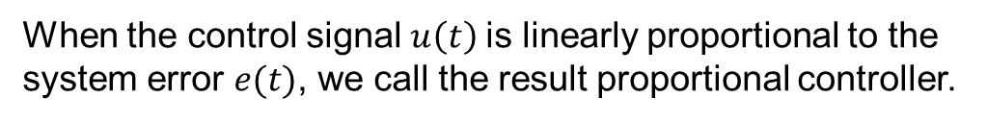
Proportional (P) Control Action
For a controller with proportional control action, the relationship between the output of the controller u(t) and the error signal e(t) is
$u\left(t\right)=K_{p}e(t)$
Eq.4
When the control signal $u\left(t\right)$is linearly proportional to the system error $e(t)$, we call the result proportional controller.
$$G_{c}\left(s\right)={\frac{U(s)}{E(s)}=K}_{p}$$
$$e(t)$$
$$u\left(t\right)$$
$$K_{p}$$
1
t
t
(a)
(b)
(c)
3

Slide 5
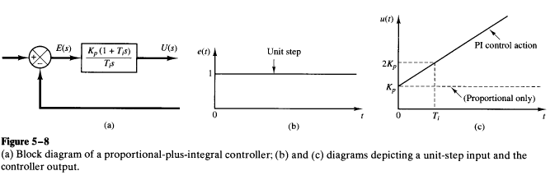

Proportional-Plus-Integral (PI) Control Action
The control action of a proportional plus-integral controller is defined by
Then, transfer function of a PI Controller is
$G_{c}\left(s\right)=\frac{U(s)}{E(s)}=K_{p}+\frac{K_{i}}{s}$
Eq.5
Eq.6
Output of the PD controller
Input to the controller
(a)
(b)
4

Slide 6
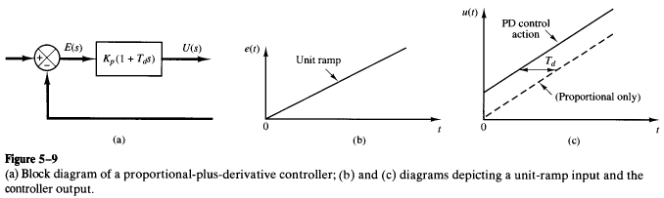

Proportional-Plus-Derivative (PD) Control Action
The control action of a proportional plus derivative controller is defined by
Then, transfer function of a PD Controller is
${ G}_{c}\left(s\right)=\frac{U(s)}{E(s)}=K_{p}+K_{d}s$
Eq.7
Eq.8
Output of the PD controller
Input to the controller
(a)
(b)
5

Slide 7
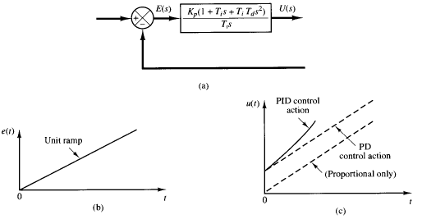
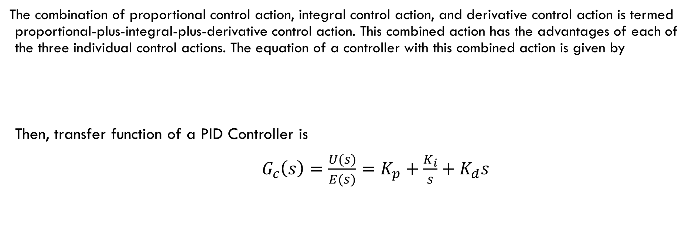
Proportional-Plus-Integral-Plus-Derivative Control Action
The combination of proportional control action, integral control action, and derivative control action is termed proportional-plus-integral-plus-derivative control action. This combined action has the advantages of each of the three individual control actions. The equation of a controller with this combined action is given by
Then, transfer function of a PID Controller is
${ G}_{c}\left(s\right)=\frac{U(s)}{E(s)}=K_{p}+\frac{K_{i}}{s}+K_{d}s$
6

